Slide 1
ITH1G4 ALGORITMA dan STRUKTUR DATA
First Meet : Course Introduction

Slide 2

Course Introduction
Course Name: Struktur Data
Course Code: ITH1G4
Credits : 3+1 SKS
14 weeks, each
3 x 50 minutes class (round up to 4)
150 minutes lab work (10 weeks)
3 x 2 hours of structured exercise
3 x 2 hours of independent activity

Slide 3


Profil Dosen
Nama : Danang Junaedi, M.T.
Kode dosen : DJN
KK : SIDE
Ruanan : IF3.02.02
Peminatan :
Decision Support System
Software Engineering
Artificial Intelligent
HCI
Ruang : IF03.02.02
HP/WA : 081320494212
Email :
danangjunaedi@telkomuniversity.ac.id
danangjunaedi@gmail.com

Slide 4
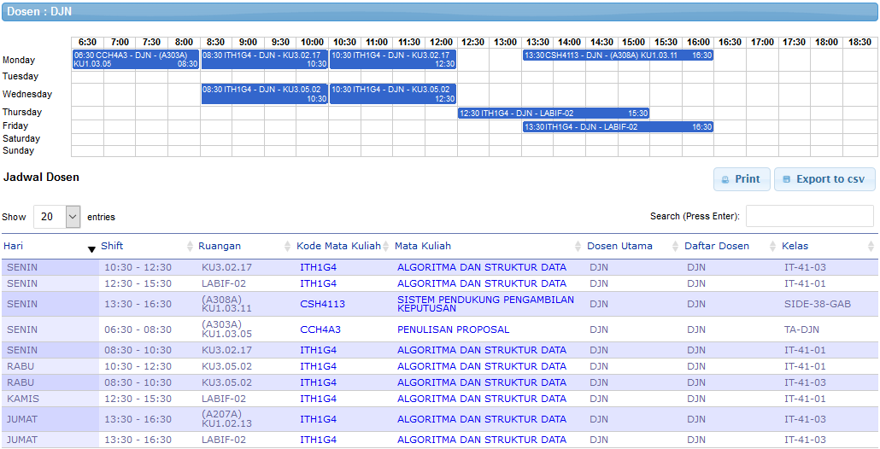
Jadwal Dosen

Slide 5

Our Rules
Any kind of Cheating and Plagiarism is not acceptable
Be responsible with your attendance
What about language?
Mind your manner
Activity is a point

Slide 6

Point distributions
Mid and Final Exam → 60%
Mid Exam 25-30%
Final Exam 30-35%
Assignment, Quiz, Project → 20%
Assignment + Quiz 0-20%
Project 0-20%
Lab Work → 15%
Presensi → 5%

Slide 7
[Possible] CLO distribution
CLO1 : Array and Linear Linked List
Exercise, Lab Assessment 1, Mid Term
CLO2 : Stack and Queue
Exercise, Lab Assessment 2, Final Term
CLO3 : Tree & Graph
Exercise, Lab Assessment 3, Final Term

Slide 8
Course Outline
Week | Subject
1 | Review Algorithm
2 | Sorting and Table Rank
3 | Pointer and ADT | CLO 1
4-5 | Linked List
6-7 | Linked List Variation | CLO 1
Mid Term
8 | Stack | CLO 2
9 | Queue
10 | Recursive
11-12 | Tree | CLO 3
13-14 | Graph

Slide 9
Course Outline – Lab Work
Week | Material/Module | Subject
1 | Cpp Introduction | CLO 1
2 | Cpp Introduction
3 | Single List
 | Assessment 1 : Single List
4 | Double List | CLO 1
5 | Circular List
 | Assessment 2 : List Variation
MID TERM
6 | Stack | CLO 2
7 | Queue
8 | Assessment 3 : Queue
 | Recursive
9 | Tree | CLO 3
10 | Assessment 4 : Tree
 | Graph

Slide 10
Final Points
A | 80 … 100.0
AB | 75 … 79.99
B | 70 … 74.99
BC | 60 … 69.99
C | 50 … 59.99
D | 40 … 49.99
E | 0 ... 39.99

Slide 11
Points – [Possible] Remedial
CLO 1
Mid Term Exam
Time : Late Mid or Late Final
CLO 2 and 3
Final Term Exam
Time : Late Final
Notes:
Late Mid = 21-23 March

Slide 12

Cheating Punishment
Proven cheating on Lab works or Exercises
Zero score on the respective task
Proven cheating during Assessment
Zero score on the respective CLO
No Remedial
Proven cheating on Final Project
Zero score on CLO 5

Slide 13

A little time to know you guys
Please answer honestly and independently
Write down your nickname, student number, class, and gender
Write down your Algorithms and Programming subject scores
In scale of 1 to 5 (1 bad, 7 good) score yourself how proficient are you in the subject?
Write down your score from Calculus I and II
How many handshakes if 5 people shakes hands with every other person?
Draw a 2D shape

Slide 14
Read:
http://anditya.staff.telkomuniversity.ac.id/academic/asd/
http://anditya.staff.telkomuniversity.ac.id/penggunaan-software-versioning-di-kelas-pemrograman

Slide 15
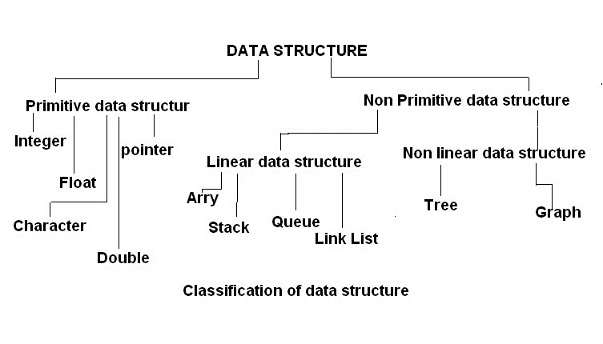
Understanding Data Structure and Algorithm

Slide 16

Organizing Data
data structure is meant to be
an organization for a collection of data items.
a way of organizing input data and operations which can be performed on this data
Organized data must be able to be searched, processed in any order, or modified
The choice of data structure and algorithm can make the difference between a program running in a few seconds or many days.
CSG2A3 – Algoritma Struktur Data
Notes:
Inti dari struktur data dalam meningkatkan efisiensi computer ada pada cara mengorganisasi data
Data yang telah diorganisasi harus bias diproses dengan baik
Cara pemilihan struktur data dan algoritma bias mengubah kecepatan computer sangat drastis

Slide 17
Why Data Structure?
In computer science, often the question is not how to solve a problem, but how to solve a problem well
In this case, it means Efficiency
Data structure is one of fundamental items to develop a good computer systems
You’ll learn Computer efficiency more deeply at other subject (Design and Analysis of Algorithms)
CSG2A3 – Algoritma Struktur Data
Notes:
Kegunaan struktur data
Di computer science, yang lebih penting tidak hanya sekedar selesai saja, namun juga selesai dengan baik,
Dalam hal ini, berarti yang dipentingkan adalah tingkat efisiensi komputer
Struktur data adalah dasar untuk membangun system computer yang bagus

Slide 18
Space-Time Tradeoffs and Efficiency
trade-off between speed and memory
To make a more powerful computers ➔ more complex applications.
More complex applications demand more calculations
CSG2A3 – Algoritma Struktur Data
Notes:
Efisiensi selalu berkaitan dengan trade-off antara kecepatan dan space memory
Makin hebat system computer yang ingin dibuat, makin kompleks aplikasi computer yang harus ada
Semakin kompleks aplikasi artinya membutuhkan lebih banyak proses kalkulasi/komputasi
Jika kita ingin proses komputasi itu cepat, kita akan membutuhkan banyak space memory,
jika ingin space memory kecil proses komputasi akan semakin lambat
Trade off ini tidak bisa kita hindari , sementara system yang diinginkan di dunia nyata sangat besar, kompleks, dan rumit

Slide 19
Selecting a Data Structure
Analyze the problem to determine the resource constraints a solution must meet.
Determine the basic operations that must be supported. Quantify the resource constraints for each operation.
Select the data structure that best meets these requirements

Slide 20
Data structure classification
Linear data structure
Stack
Queue
Non-linear data structure
Tree
Graph

Slide 21
Course Outcome
To be able to choose the best data structure for a case
Understand the process and implementation of linked list structure
Implementing linked list data structure to a real case : stack, queue, tree, graph

Slide 22
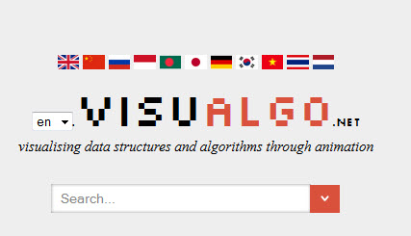
Visit

Slide 23
Question?

Slide 24
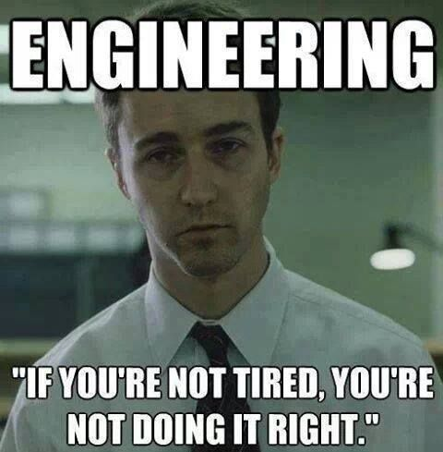

Slide 25

Programming and logic is depend on how often you practice

Slide 26
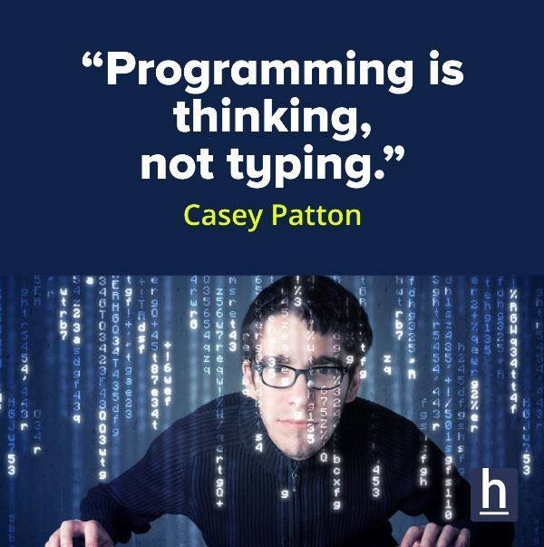

Slide 27
Exercise
Write an algorithm to compute the formula down
Example
Input a : 2
Input b : -3
Input c : 1
Output x1 : 1
Output x2 : 0.5

Slide 28
Exercise
Write an algorithm to raise any number to any power.
example
Input number : 2
Input power : 3
Output : 8

Slide 29
Exercise
Write an algorithm that determines the type of a Triangle given the size of the three sides
Example
Input Side 1 : 4
Input Side 2 : 6
Input Side 3 : 4
Output : isosceles

Slide 30
Exercise
Write an algorithm to receive input number from user until user input = 9999. The program will output the minimum number inputted
Example
3
6
2
6
9999
Output : 2

Slide 31
Exercise
Write an algorithm to receive input number from user until user input = 9999. The program will output the minimum number inputed
Example
3
6
2
6
9999
Output : 2

Slide 32
Exercise
program temperatur converter [farenheit -> celcius]
C = (F - 32) * 5/9
buatlah program untuk mengubah input suhu farenheit menjadi celcius
program akan menerima 3 buah input angka real dari user
program akan mengoutputkan hasil perubahan suhu ketiga inputan

Slide 33
Exercise
buatlah program untuk menghitung indeks nilai
Input 3 nilai : UTS, UAS, kuis
Hitung nilai akhir = 35% UTS + 35% UAS + 30% kuis
Tampilkan index nilai sesuai aturan
A : 80 - 100
AB : 75 - 79.99
B :70 - 74.99
BC : 60 - 69.99
C : 50 - 59.99
D : 40 - 49.99
E : 0 - 39.99

Slide 34
Exercise
Create an algorithm to draw a diagonal
Example :
Input 5
Output
- - - x
- - x –
- x - -
x - - -
x - - - -

Slide 35


Slide 36
Github.com
Create github.com account
Install github for windows
Open https://github.com/DanangJunaedi/ASD
Fork a repository
Clone the repository to your PC
Modify the file(s) with your solution to complete the task
Add the files using : git add .
Commit the modification using : git commit –m “message”
Push the modification using : git push
Create a pull request
At the due date I will close the request with message

Slide 37

Home Task
Install a C++ IDE or compiler program
At lab works we use Code::Blocks IDE
Create an empty Cpp project

Slide 38
Home Task - Simple Calculator
Create a simple calculator program that ask input operan1, operan2, and operator from user and output the result
Make the program ask if the user wants to do the calculation again and loop the program

Slide 39
Learn to Code
Learn programming using C-family programming language
Get used to it :
operators ( ==, !=, ++, --, +=, -=, *=, etc )
Starts array and increment from 0
Use
For ( int I = 0; I < 10; I++ )
Rather than
For ( int I = 0; I <= 9; I++ )

Slide 40





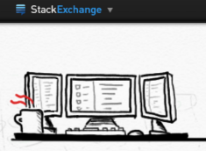


Learn to Code

